Slide 1
INDUSTRY ORITENTED AUTOMATION ROBOT
BVRIT HYDERABAD College of Engineering for Women
Department of Information Technology
Team – 17
V Sai Akshitha(19WH1A1212)
Athiya Fathima(19WH1A1232)
Priyanka Kolli(19WH1A1236)
M Preethi(19WH1A1259)
Under the Guidance of
Ms. Ch. Sai Lalitha Bala
Assistant Professor

Slide 2
SUMMARY OF STAGE - I
The Industry Oriented Automation Robot can be used to monitor an industry’s environment using sensor.
In stage-1, only the Light detection by LDR Sensor, Obstacle Detection by Ultrasonic Sensor were implemented.
In stage-2, Fire detection by Fire Sensor, Gas detection by Gas Sensor, Metal detection by Metal Sensor and Collection of metal particles by Magnet Sensor modules were implemented.

Slide 3
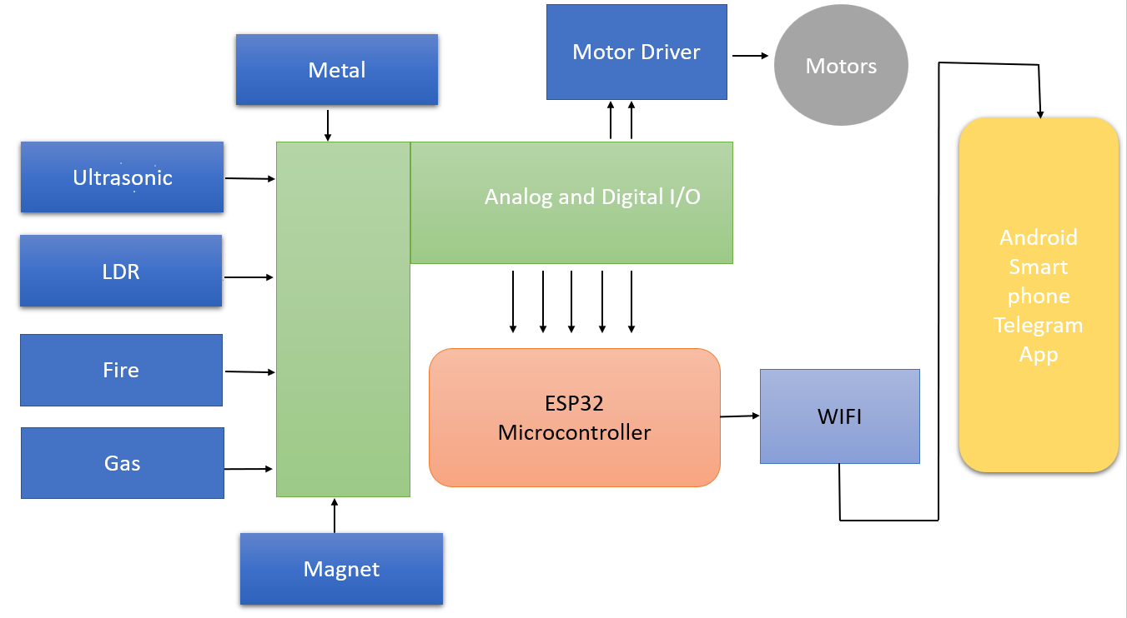
ARCHITECTURE

Slide 4
MODULES
Light Detection
Obstacle Detection
Robot Detection
Fire Detection
Gas Detection
Metal Detection
Collections of Metal Particles

Slide 5
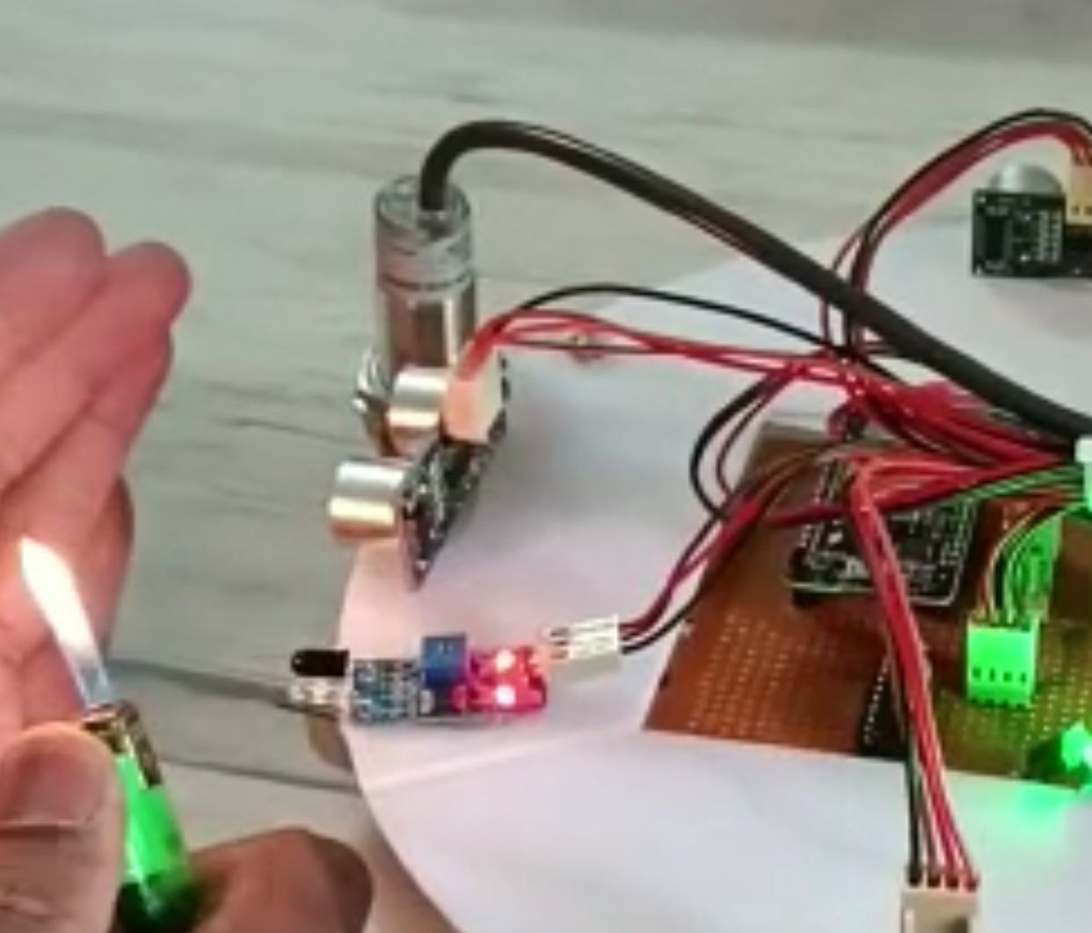
IMPLEMENTATION OF EXPERIMENTAL DESIGN
1. Fire Detection
Fire/Flame sensor infrared receiver module ignition source detection module is Arduino compatible and can be used to detect flame or wavelength of the light source.

Slide 6
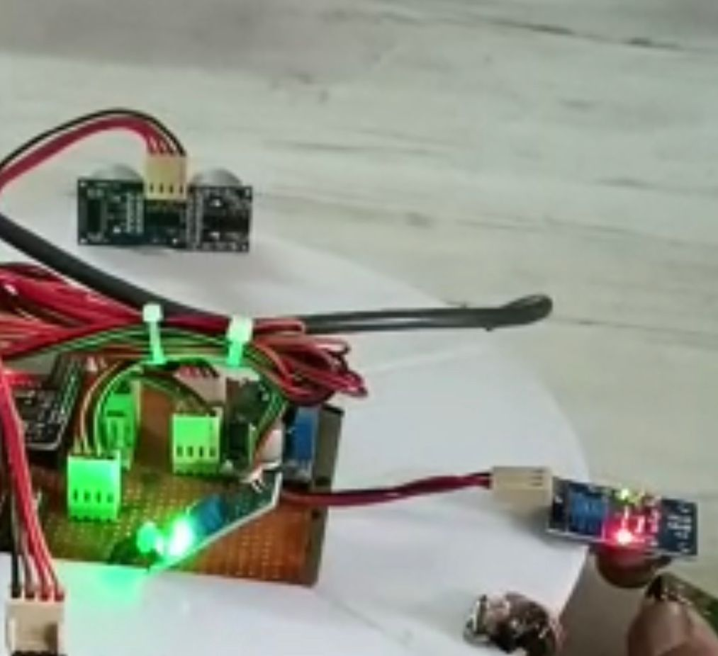
IMPLEMENTATION OF EXPERIMENTAL DESIGN
2. Gas Detection
Gas sensors (also known as gas detectors) are electronic devices that detect and identify different types of gases. They are commonly used to detect toxic or explosive gases.

Slide 7
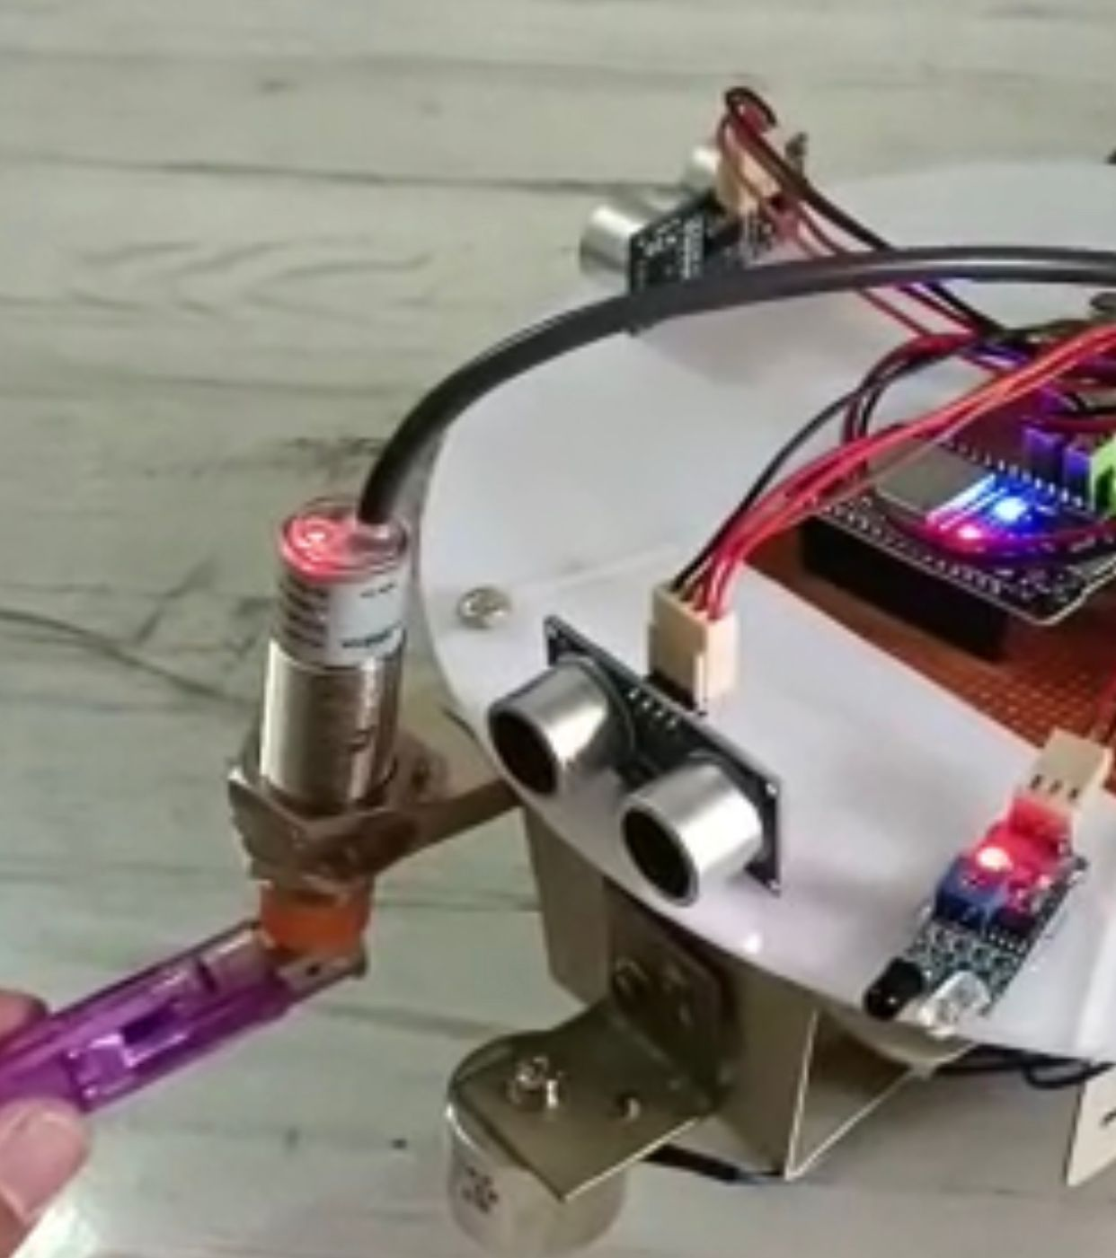
IMPLEMENTATION OF EXPERIMENTAL DESIGN
3. Metal Detection
A metal detector is an instrument that detects the nearby presence of metal. Metal detectors are useful for finding metal objects on the surface.

Slide 8
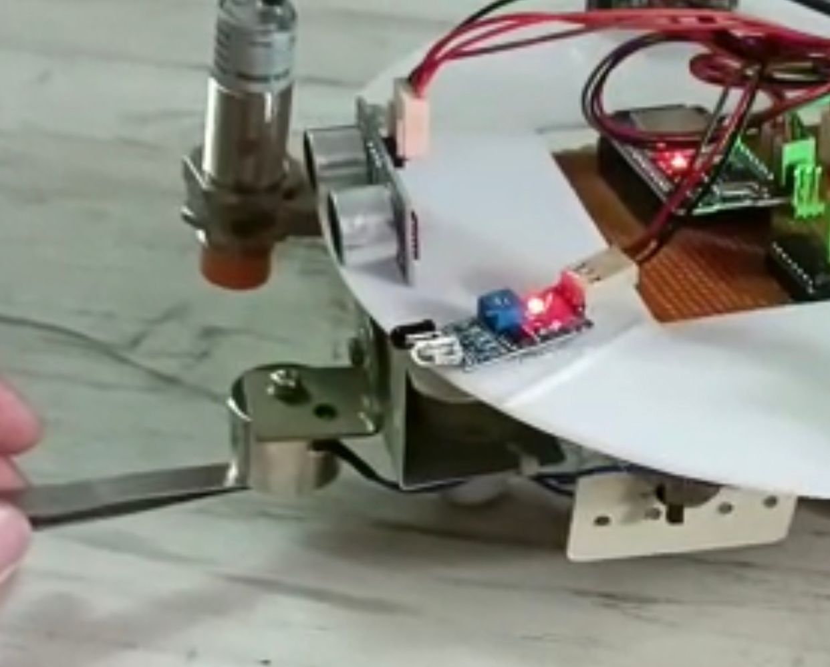
IMPLEMENTATION OF EXPERIMENTAL DESIGN
4. Collection of Metal Particles
As the metal sensor identifies the presence of metal particles, the magnet positioned next to it can be helpful to collect the metal particles.

Slide 9
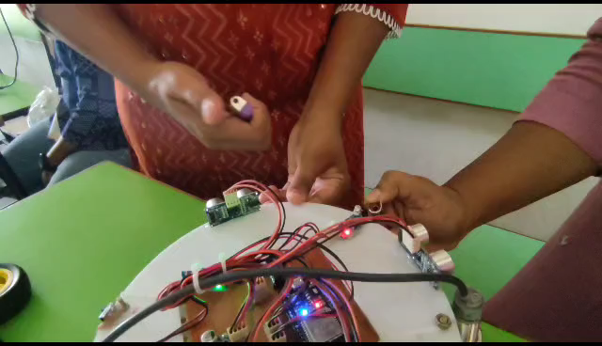
Execution video

Slide 10
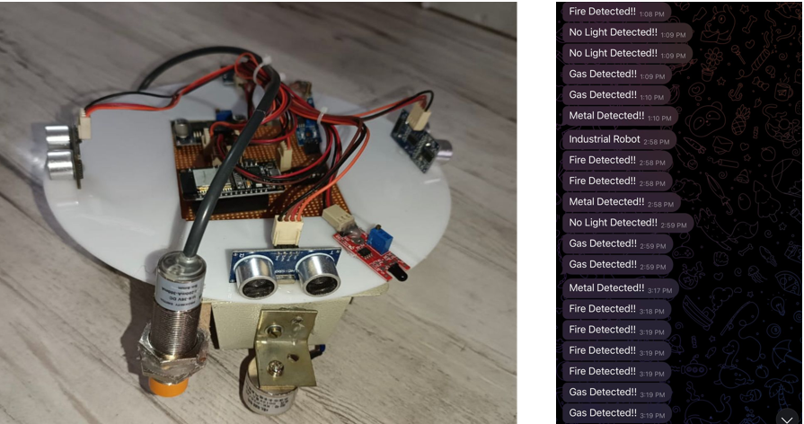
RESULTS

Slide 11
CONCLUSION AND FUTURE SCOPE
The system is suitable for real time small scale industrial process monitoring and controlling applications.
The objectives of the industrial automation robot are to improve safety, enhance efficiency, improve quality, provide real time monitoring, offer adaptability, and remove metal debris.
Along with these features that we have implemented, one can also try do add a vacuum module that can pick-up any dust particles that are present on the floor on which the robot moves.
In order to improve our ability to judge from our gaze, controlled cameras can help with vision-relate.

Slide 12
THANK YOU!!

